Slide 1

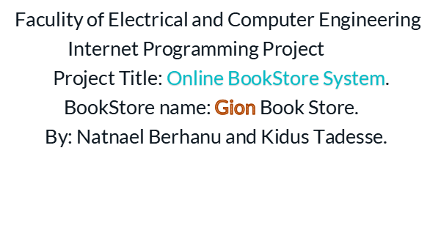
Bahirdar Institute of Technology

Slide 2
Contents
1.Objectives
General Objective
Specific Objective
2 Stating Problem
3. Methodology
4. Demonstration

Slide 3

Objective of the project
1.General Objectives
Our main objective is to Design an online bookstore automation named Gion Book Store that mainly sells Varity of books with facilitated customer service.

Slide 4
2.Specific Objectives
To Design such a system which one can say 'goodbye' to the days when He stood in line waiting, and waiting some more for a store clerk to finally check out His items.
To design online shopping system which has friendly customer service representatives available 24 hours a day, 7 days a week to assist customers with locating and purchasing Books.
To Design online shopping system in which Customers will be able to search or visit categories to find the books they want, check the availability, and place the order to buy the book using Bank.

Slide 5
Problem statment
Almost every activity in the world today is controlled by computer driven software programs. As the life style became more and more advanced, every area of human interactions was invaded by various software systems, such as simulation, embedded, web based, and more recently, artificial intelligence software etc.
According to the above facts, managing and maintaining a book store could also be controlled by efficient software. This project focuses attention on designing efficient and reliable software
Which controls the customer service and transactions of a bookstore.
.

Slide 6
In real world, it tends to associate with automated systems as they provide many benefits than doing the same thing in manually. As above mentioned, here we have introduced a system which can be used to maintain a bookshop.When we are concerning the manual process of a bookshop, the major problem is the waste of time. A customer has to waste his/her valuable time when he needs to buy a book as all the events such as searching, purchasing are done by members of the staff .In briefly, the manual process is very slow.
But automation will reduce the time taken in the whole process. In a bookshop we should deal with a large store. Communication with suppliers, customers and When the bookshop issues an item to a customer, all the stages of the transaction procedure will be facilitated by the system & it will be more accurate and be more successful as the system is so fast.

Slide 7
Languages
Used
In this project, several technical approaches are used:
  HTML language for WebPages design and implementation
  CSS for styling and presenting the web site
My SQL for reational database system.
  PHP for database connection.
SQL, structured Query language is used to access and manipulate database.
Java Script technology for client-server communication.

Slide 8
Methodology
Collecting data,images that are use full for implementation
Select Template which can best fit our project Title (book store web site template)
Customizing web template

Slide 9
Graphical Representation Of Bookstore System
user interface
command
result
control function
Search,update
retrive
Local Database
product tables
message tables
table cart
user table
order table

Slide 10
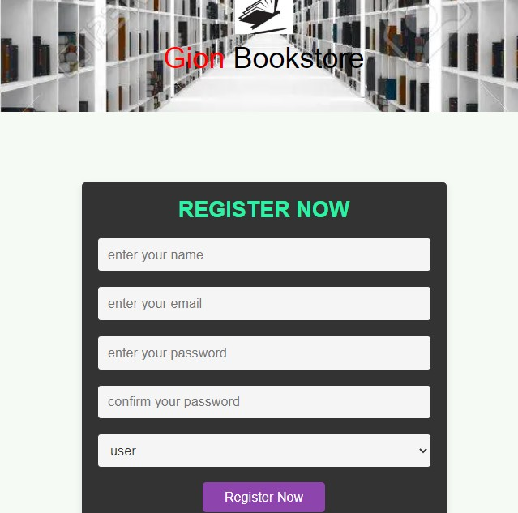
Demonstration
A. User Registration Form

Slide 11
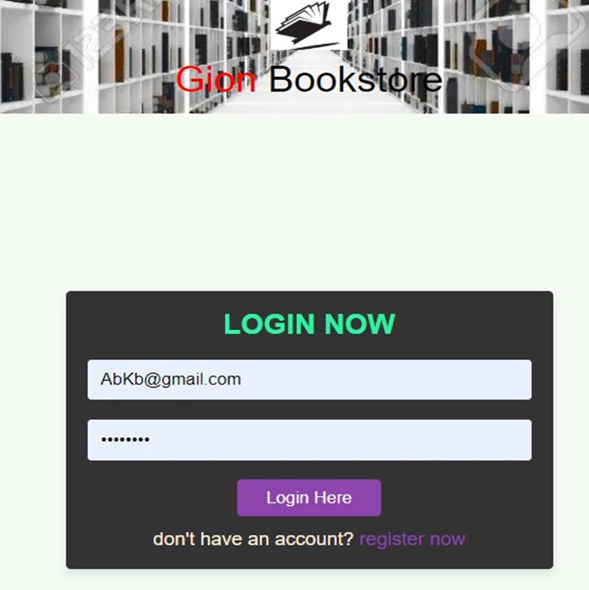
B. Login Form

Slide 12
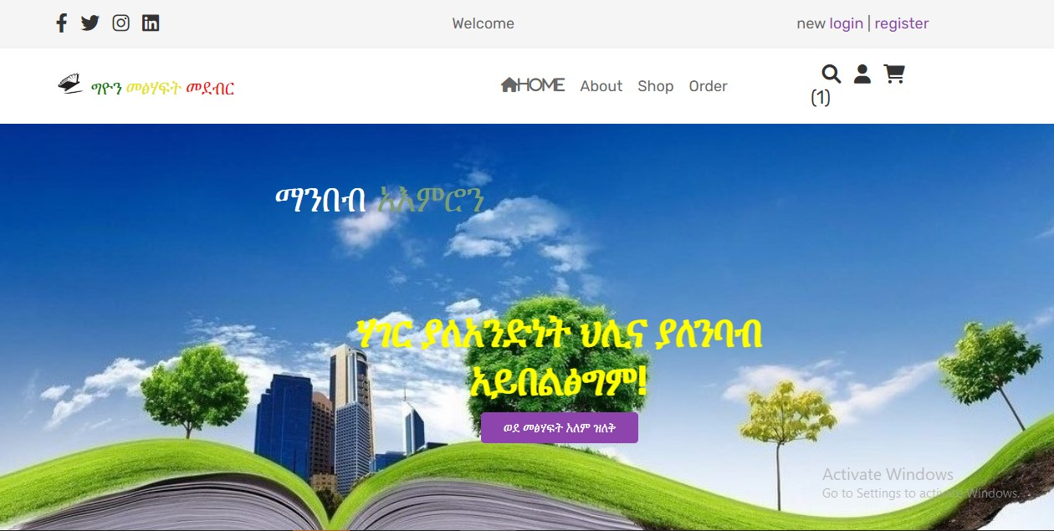
C. Home page

Slide 13
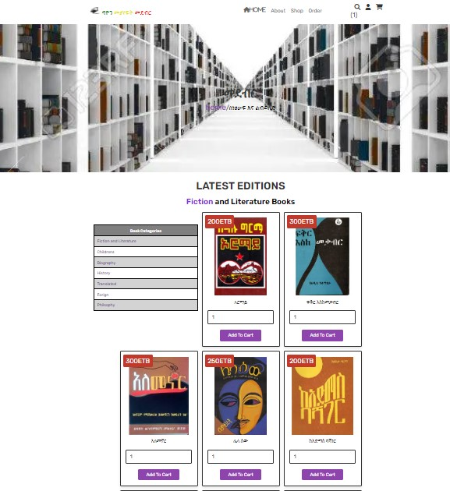
D. shop page

Slide 14
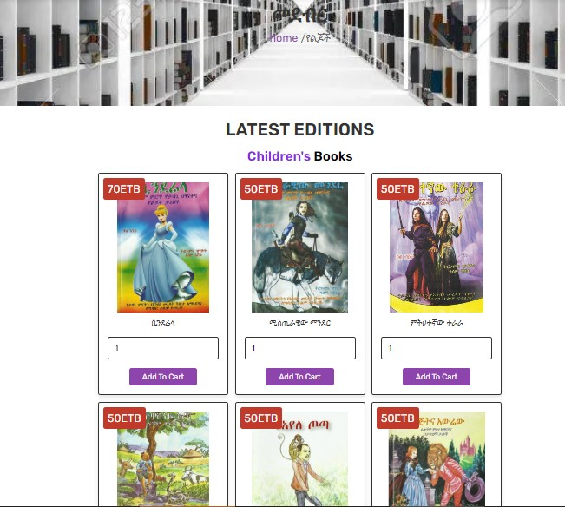
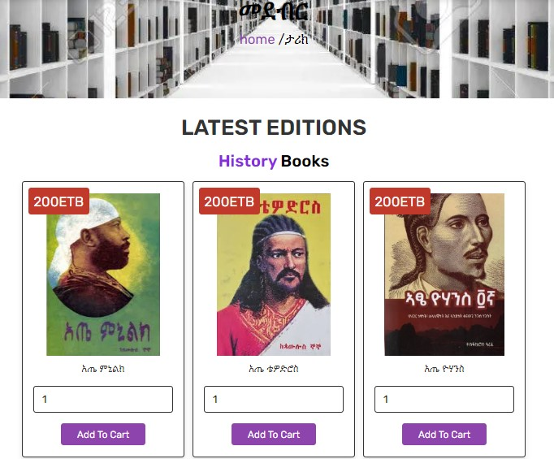
E. sample categories

Slide 15
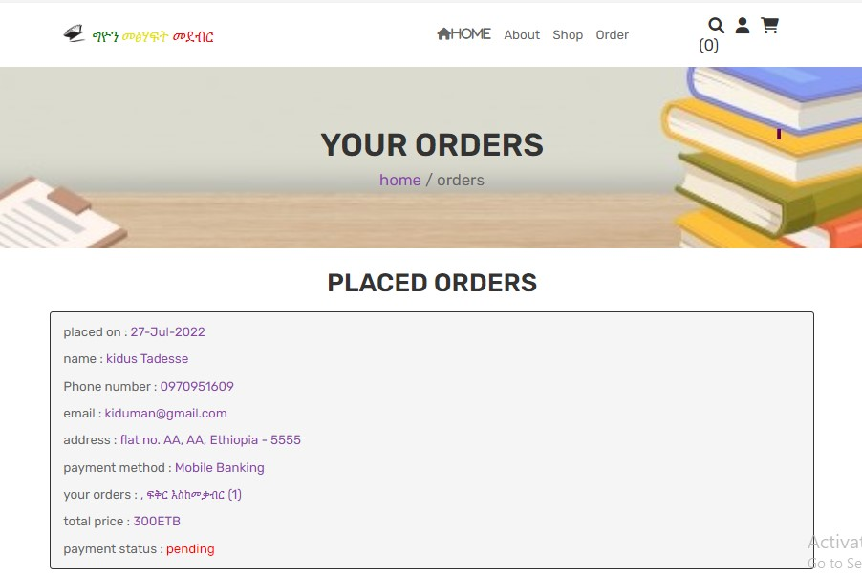
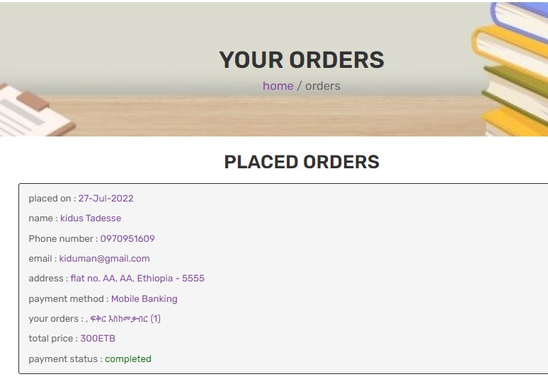
F.Order Page

Slide 16
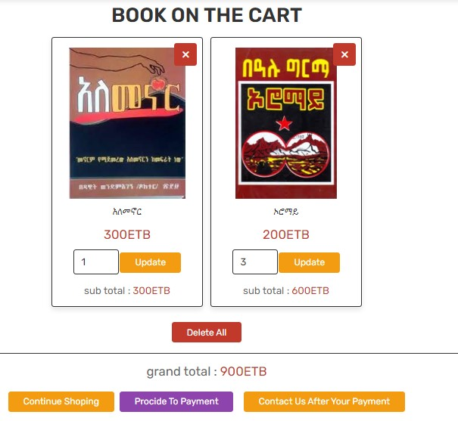
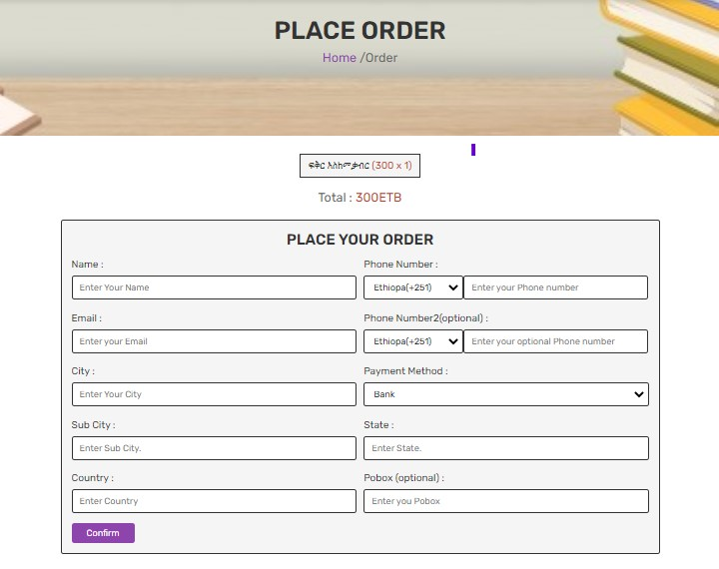
G. Cart and Payment Page.

Slide 17
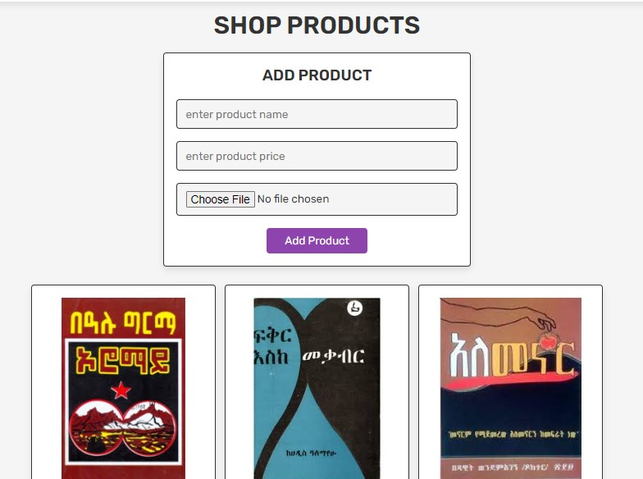
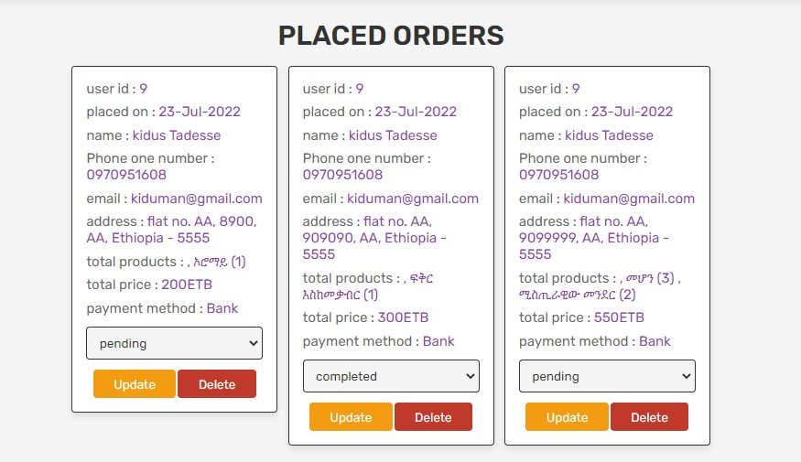
E. Admin

Slide 18
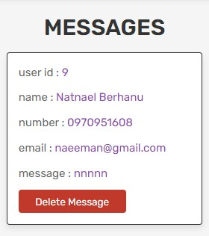
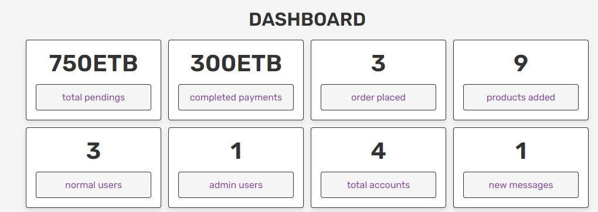
E. Admin

Slide 19
ሃገር ያለአንድነት ህሊና ያለንባብ አይበልፅግም!

Slide 20

Team Presentation
KIDUS TADESSE
NATNAEL BIRHANU

